Slide 1
Task Analysis

Slide 2
Task analysis
A description of how to do the task
  Just a list,
  A network
  Timing predections
  A program that can do it itself, e.g, Nasa Pride, or, you can do it
Many methods
Many uses
  Describing, understanding, predicting behavior
  Comparing designs (old vs new, competing)
  Checking task support
  Training users, creating manuals
  Predicting mistakes
  Allocating tasks to multiple users

Slide 3
Task analysis
Many ways to collect data to build a TA
  For instance, in the New England Telephone case, performance on the existing system was measured using videotaped records of usage, but performance on new system was predicted using system specifications

Slide 4
Task analysis
Not always useful in and of themselves
However,
  A good UI designer can use them to spot problems, suggest improvements
  They also add to a designer’s store of experience and expertise, thus helping him or her understand users better

Slide 5
Example: EMS/Hospital Comms
Problem: EMS arrives at hospital with patient unannounced
  EMS called ahead with patient info, but no-one picked up the phone
Observe process from both ends
  Ambulance
  Hospital
Patient Info as a package
  Who has the ball?
Notes:
Here is an example of task analysis used to identify a cause of an observed problem not in a UI, but in a work process. In this case, a hospital was sometimes receiving patients unannounced. Understandably, the ED nurses want to have as much info on the patient as possible before they arrive, and are very annoyed at the EMTs who show up with no warning.
EMS claim they call, however no one picks up the phone. By the time they give up trying to reach someone, they are ~2mins away from the hospital anyhow.
While both parties are professional toward one another, this is a source of workplace friction that might be solved through a process improvement.
Understanding a process from both sides allows the designer to understand where common points of failure are as well as how different groups use the same system in different ways.

Slide 6






























Visualized Workflows
EMS
Receive Call from Dispatch
Announce to Radio Network
Assess/Treat Patient
Call Hospital with Patient Information
Send 12-lead EKG data
Arrive at Hospital, meet with ED nurse
Technology
Phone/Radio
Wi-fi, Cellular, or Radio
Place patient in Hospital Room, begin treatment.
Open EMS Radio Frequency
Receive Call from EMS, begin patient report.
Attach 12-lead data to patient report
Place hard copy of report outside patient’s room.
Receive patient, exchange further info with EMS.
Hospital
EMS/Police Frequencies monitored for situational awareness
Determine which room to place patient in and Dr. for initial treatment.
Hospital Phone
Medical Command
Beard, 2015
Notes:
Two sides of collaborative sensemaking with comms medium in between.
EMS, emergency dept.
Dispatch call goes out over open radio net, ambulance responds with coded signal. They notify everyone that they are en route to the scene of the call. Announce arrival as well.
Call is on open net, monitor clerk has scanner at desk for situational awareness.
EMS arrives on the scene and begins treatment.
EMS calls in to ED. Can still be on the scene or driving to hospital. Call goes out over radio or cell phone, at ambulances discretion. Radio has advantage of reliabilty over cell phone, however voice quality is much clearer on phone. There are areas on campus that are "dead zones" for both. Experienced EMTs will try to call before entering these areas. Observed behavior in both ED and ambulance shows that EMTs generally prefer to use phones, however it depends on the specific caller.
Once call is received by ED clerk, he asks if caller needs medical command. Here the call gets complicated, as medical command is a physician on call elsewhere in the hospital.
Roving nurses and doctors are issued cordless phones on a hosptial network, and they answer a page from the clerk if a medical command is requested.
The call is routed through the clerk's phone as a conference call, and the line is tied up for the duration of the call.
If the clerk hangs up, the call is interrupted.
If medical command is requested or not, the clerk takes down pertinent information from the ambulance crew on a Transfer of Care Report. This report is usually the first page in a patient's file.
If necessary (at ambulance's discretion) 12-lead EKG data is transmitted to a special terminal in the hospital. This terminal displays the time and source of the transmission. This is printed out on special adhesive tape and attached to the Care Report.
The clerk then uses this information to assign a room and doctor to the incoming patient. The clerk will typically announce the info for the patient to the rest of the office and get information from the other on-call nurses about what rooms are available.
The clerk then physically walks the hard-copy form to the empty room (ideally before the patient arrives)
During this time, the clerk is away from the desk. If another call comes in, it falls to the rest of the office to answer the phone or just let it ring.
When patient arrives at ED, the EMT finds a shift nurse to sign off on the reciept of the patient.
By looking at the process from both sides the observer can understand how and when information is exchanged. For example, the information changes hands halfway through the patient transport process, and in this instance the exchange goes through a single point.
Again, this is an example of how a task analysis exercise, while not supporting the design of a new product, can uncover the causes of problems or points in a work process where failures may occur.

Slide 7
Hierarchical TA
Decomposing goals into subgoals, revealing order and structure
More of a representational device than a technique
  Data could be gathered in multiple ways
  Not a detailed approach, suggestions are not detailed
Easiest method – no actual UI required, can be done quickly and early, can be converted into a GOMS analysis later

Slide 8
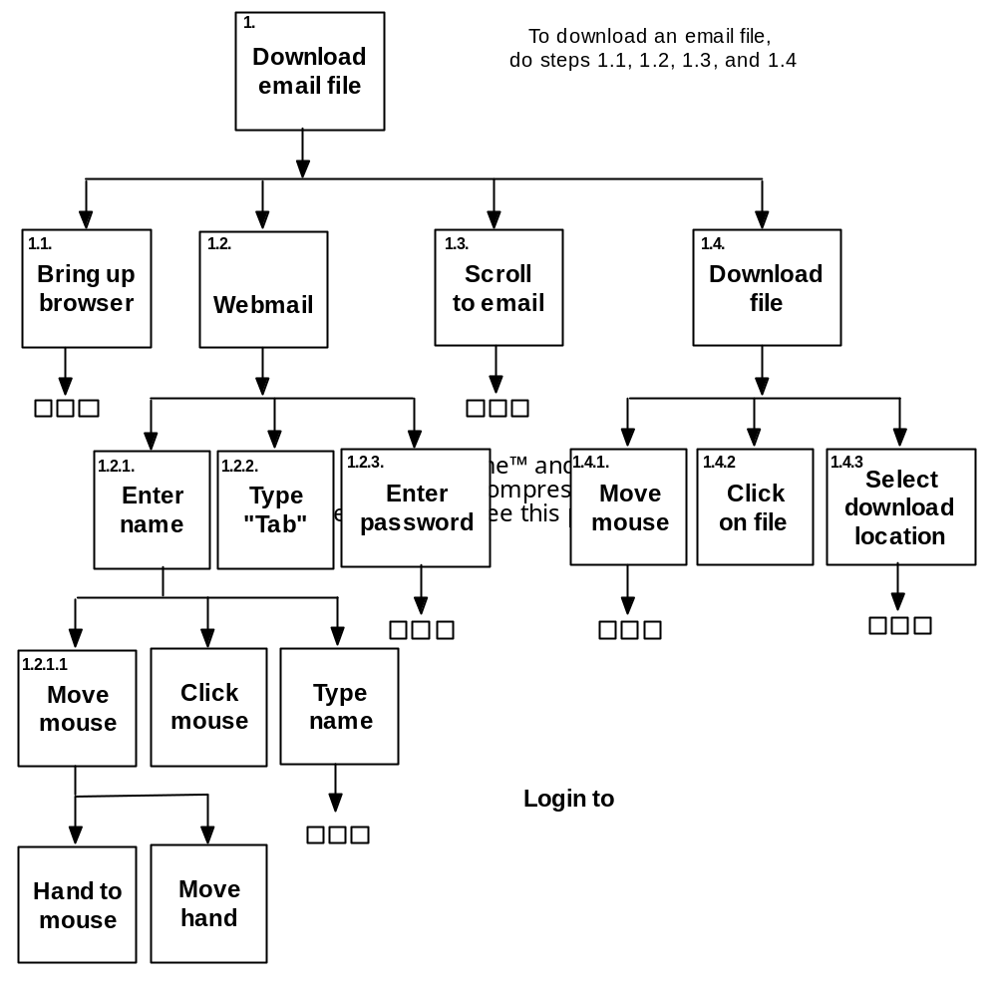
Hierarchical TA

Slide 9
GOMS
Created by Card, Moran, Newell in 1983
Goals, Operators, Methods, Selection rules
  Goals: desired states of affairs
  Operators: motor, cognitive or perceptual actions – lowest level of granularity
  Methods: procedures for achieving goals/subgoals
  Selection rules: rules for selecting the best method (when multiple methods are available)

Slide 10
GOMS
Specifies error-free, expert behavior
  However user may not be trained
Acknowledges that multiple strategies may be available to achieve a goal
Makes explicit the lowest level of granularity (compared to HTA)

Slide 11
GOMS
Problem: no such thing as ‘error-free performance’
  Still better than nothing though
  See new work by Paik, Kim, Ritter, & Reitter
Problem: Where to get the specification for selection rules? Current context implied, but previous selections could also be used in real life

Slide 12
GOMS
Basic GOMS doesn’t support task interleaving/multitasking – variations exist that add support
  The New England Telephone case used CPM-GOMS – multi-tasking during slack time was a critical part of the analysis

